Slide 1
O2CM Website Redesign
Arthur Lockman, Isamu Nakagawa, Tucker Haydon

Slide 2
Before

Slide 3
After

Slide 4

Achievements
User Surveys
Data Scraper/Parser from live website
Firebase database
RESTful API
React

Slide 5
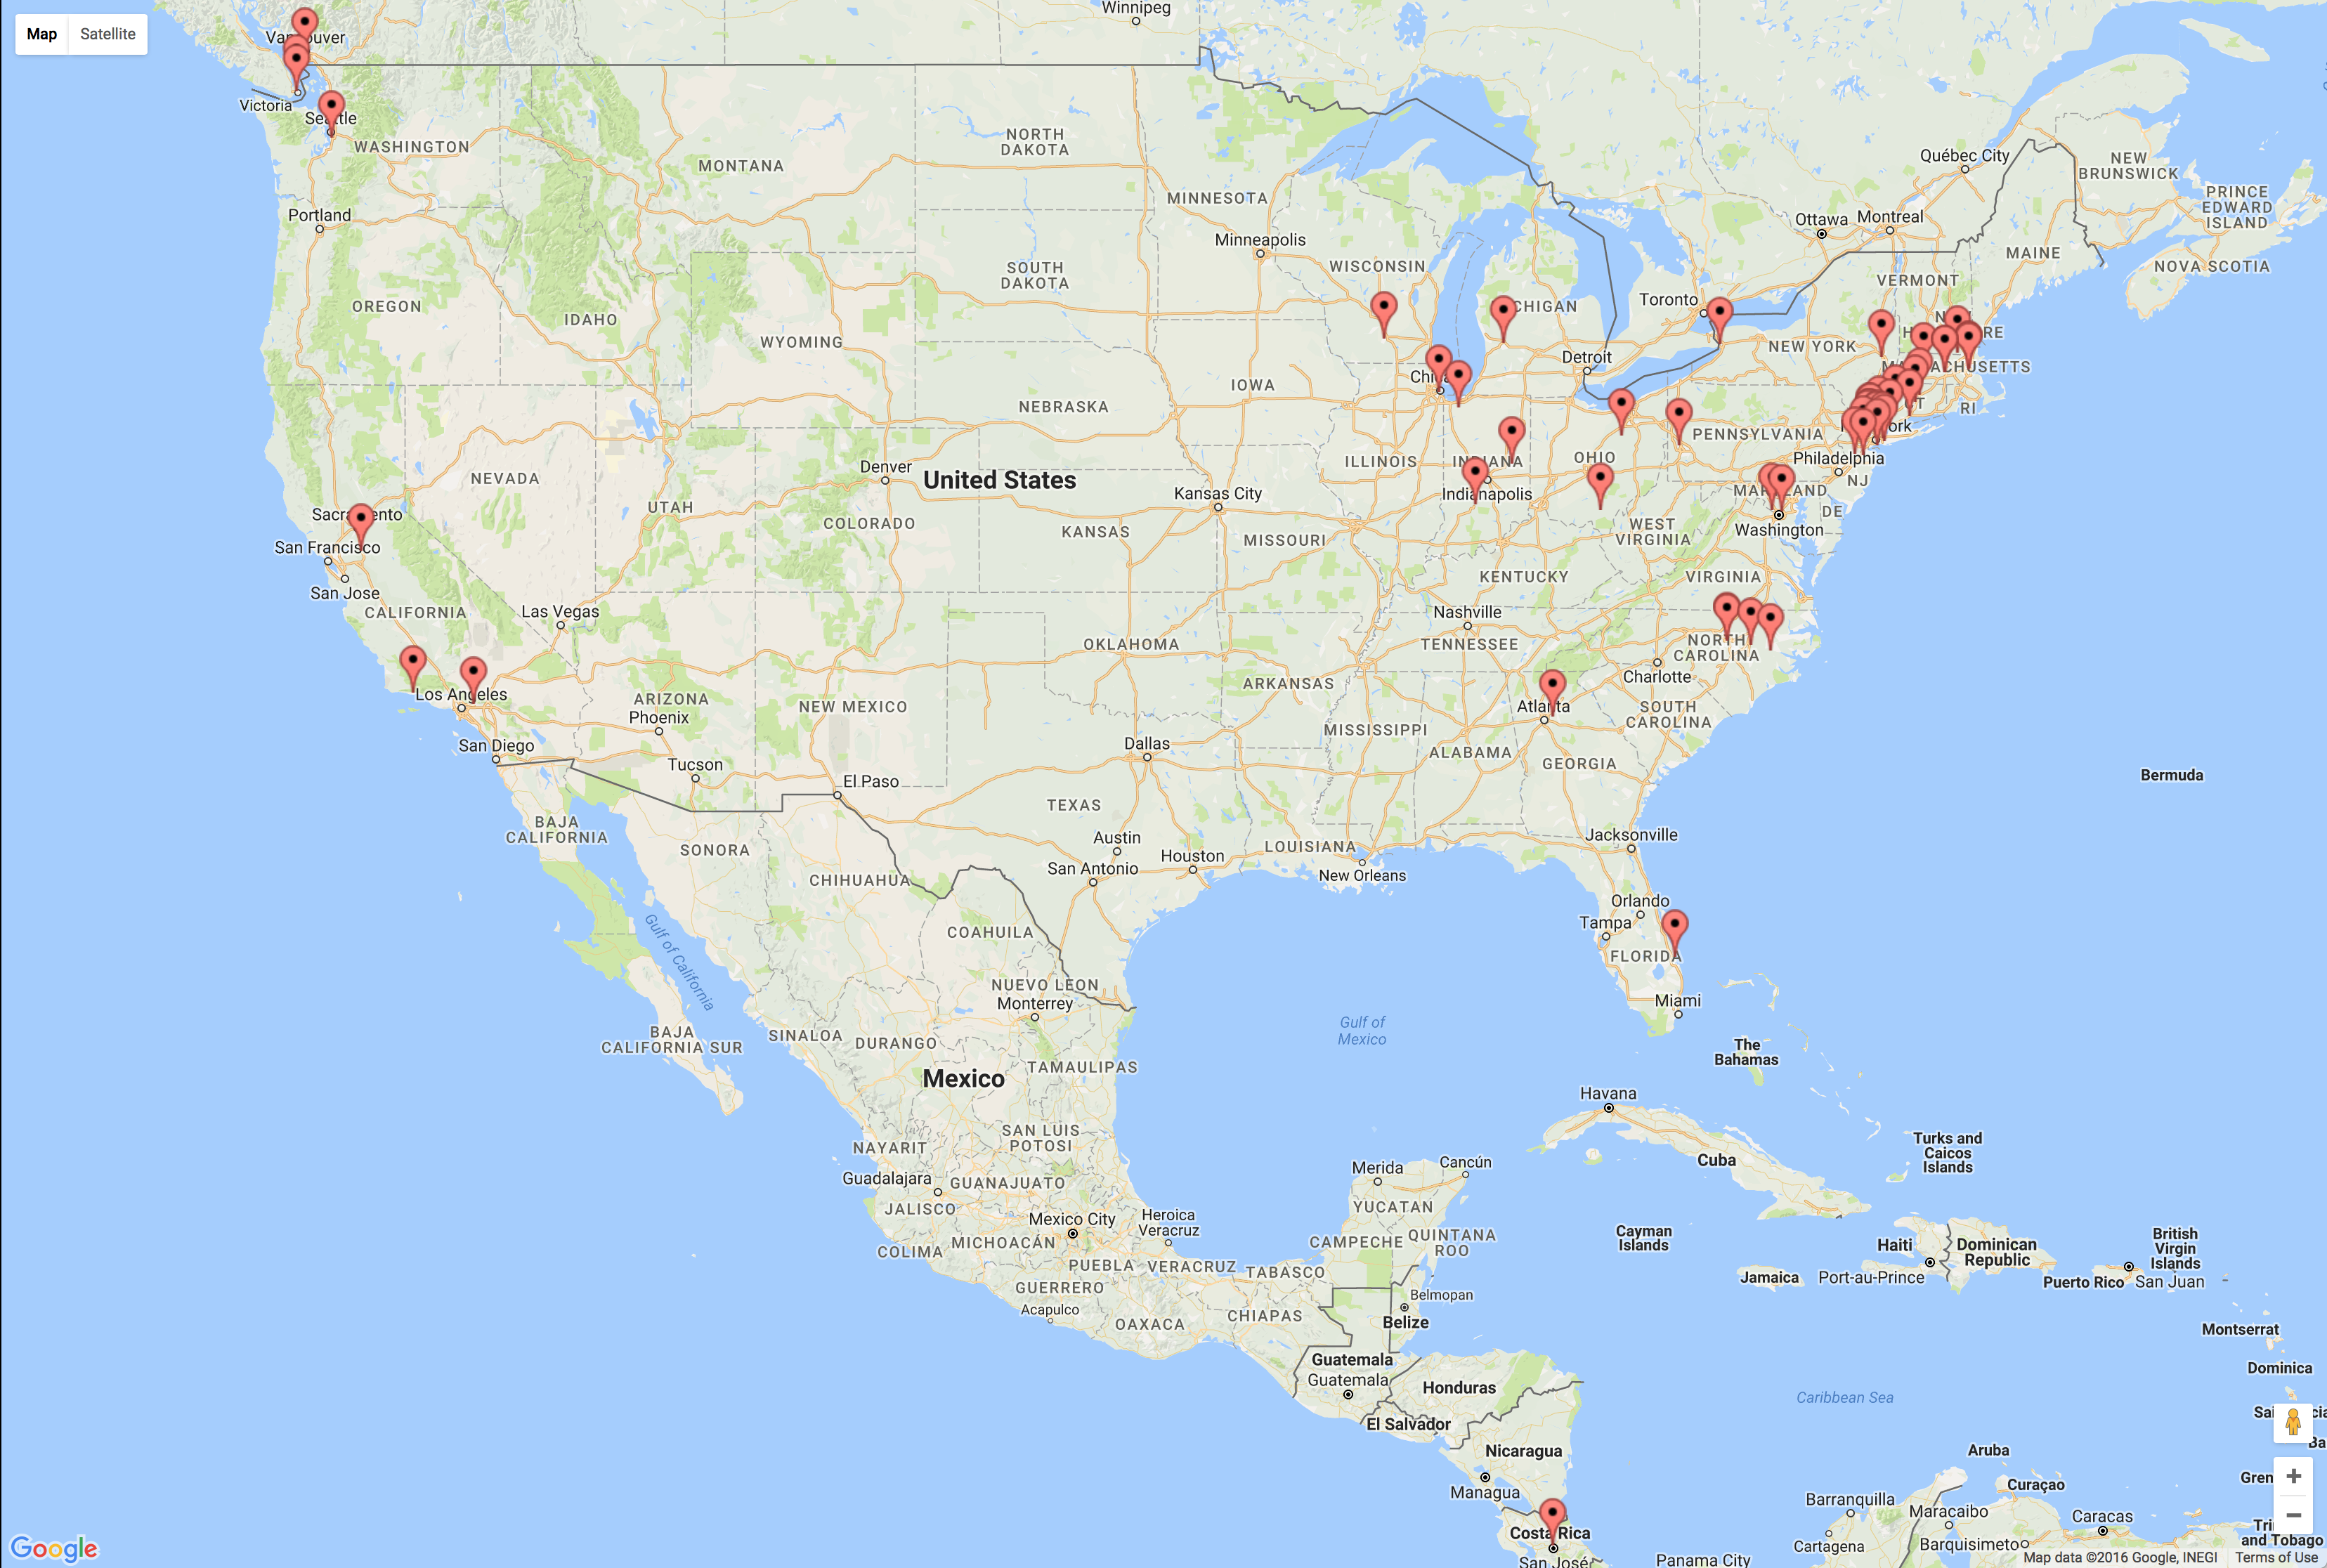
Survey – 10 Questions – 86 Responses

Slide 6
What they like
What they don’t like
Tabular display of data
Easy to visually understand once you’ve seen it before
Website navigation
Page space not used well
Looking up couple numbers
“Navigating the website is cancer”
“Use more than just the leftmost 1/8th of the screen”

Slide 7
Challenges
Burn React to the ground

Slide 8

Dirty Data
Notes:
‘1/8 Final’
American Waltz
American Waltz*

Slide 9
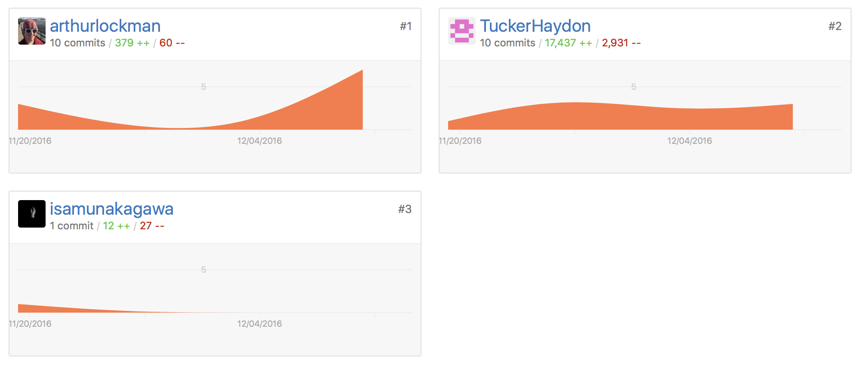
Let’s play: Guess the Data Miner!

Slide 10


Slide 11


